Slide 1


Slide 2
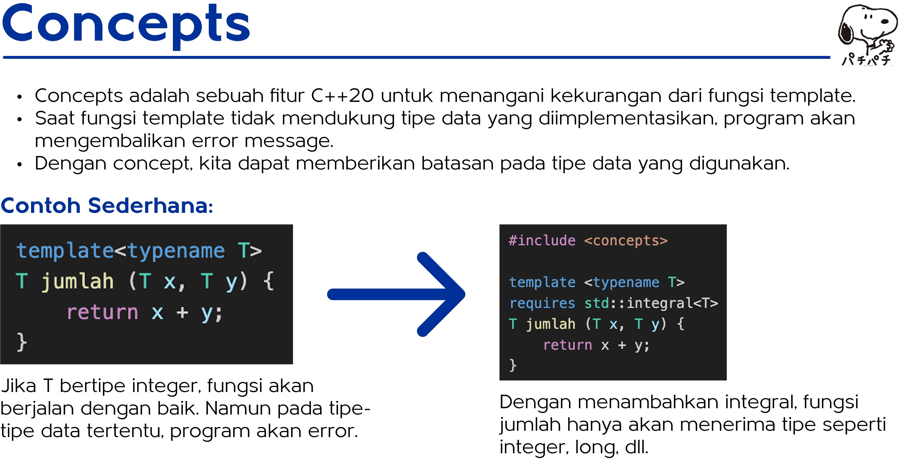

Slide 3
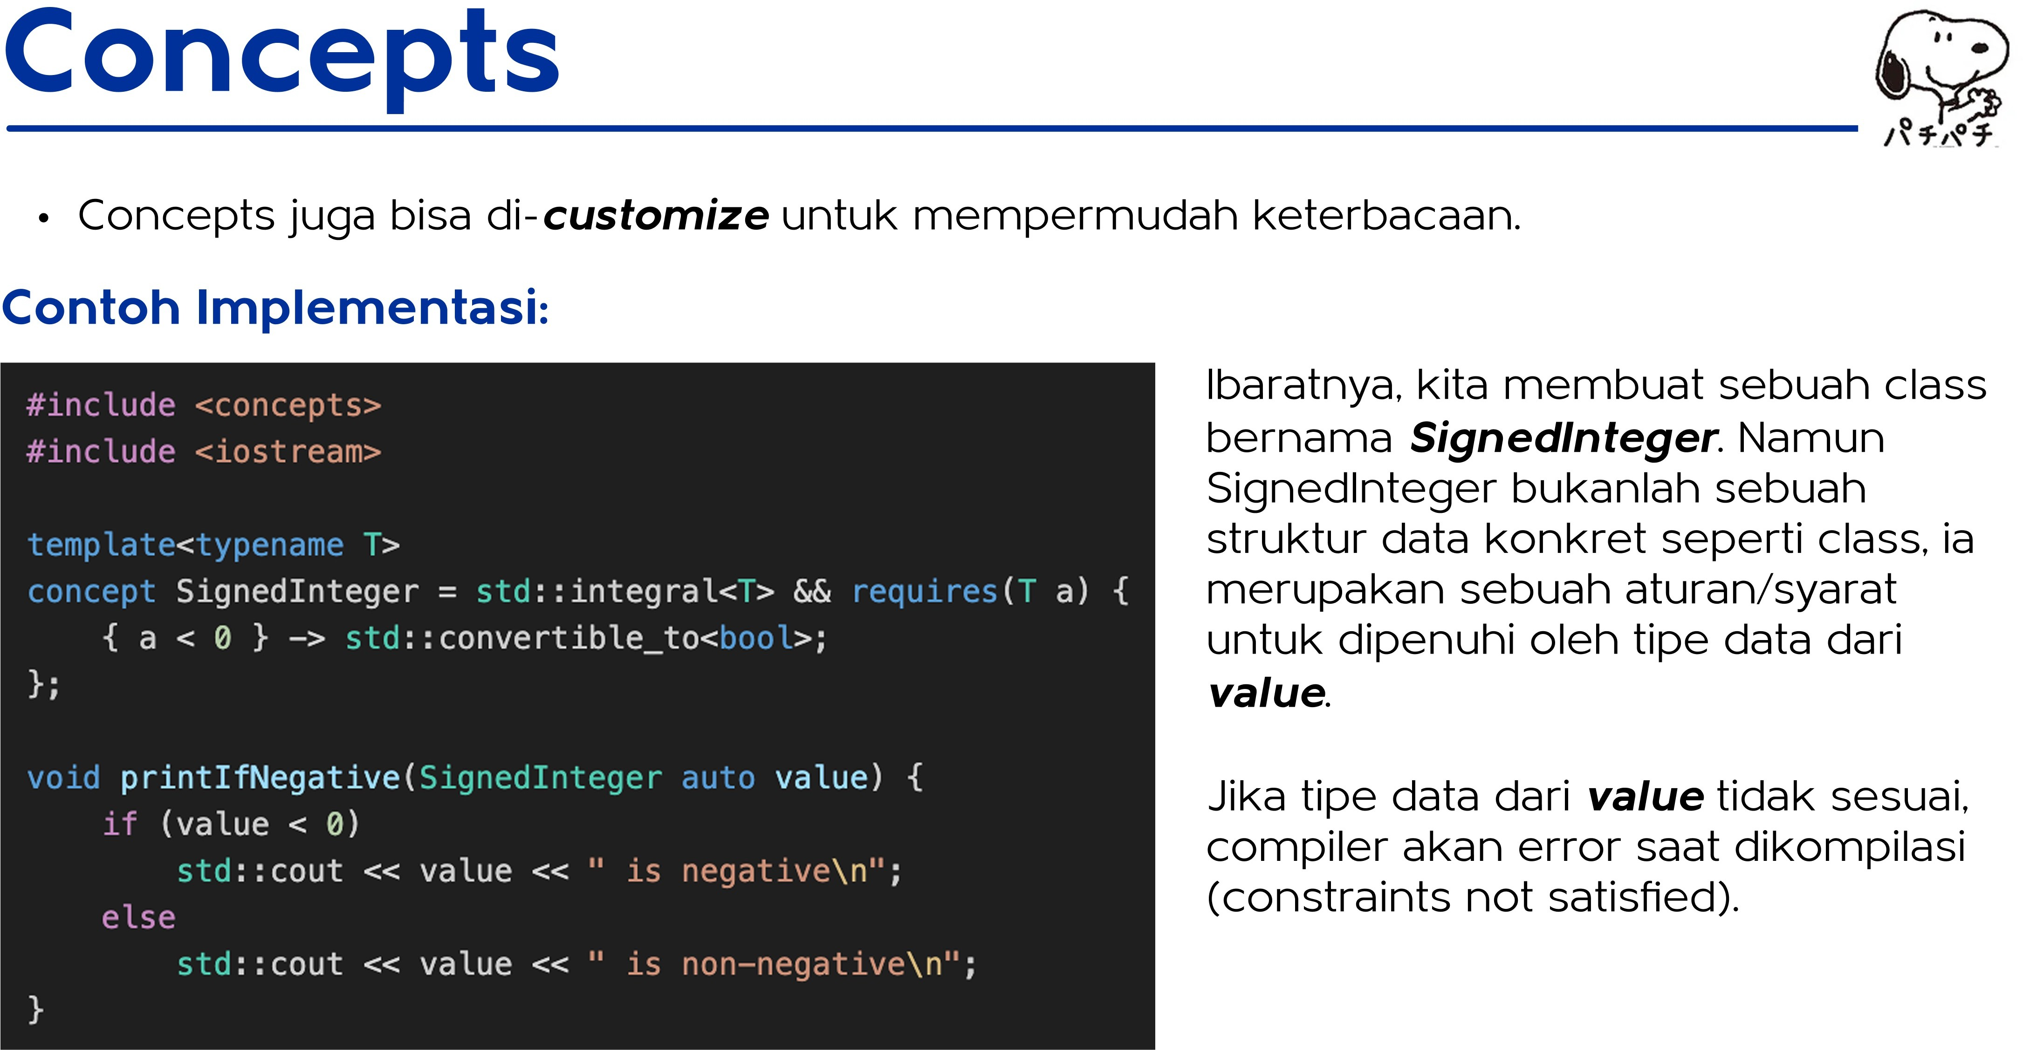

Slide 4
once
aia sian ar rar
asi
an
en.c
enis an erence.co
sin a.
conce
Defined in header «concept s»
same as (Co +20)
derived row (C+ +20)
Comparison concepts
Defined in header <concept s>
box lean - Yes job be ( +- 20)
specifies that a type is the same as another type
(concept)
specifies that a type is derived from another type
(concept)
specifies that a type can be used in Boolean contexts
(exposition-only concept*)
Object concepts
Defined in header «concept s»
specifies that an object of a type can be moved and swapped
(concept)
specifies that an object of a type can be copied, moized, and swapped
(concept)
copyab1e (cv + 0)
Cal able concepts
Defined in header <concept s>
specifies that a callable type can be invoked with a given set of argument
types
(concept)
(C+ +20)

Slide 5
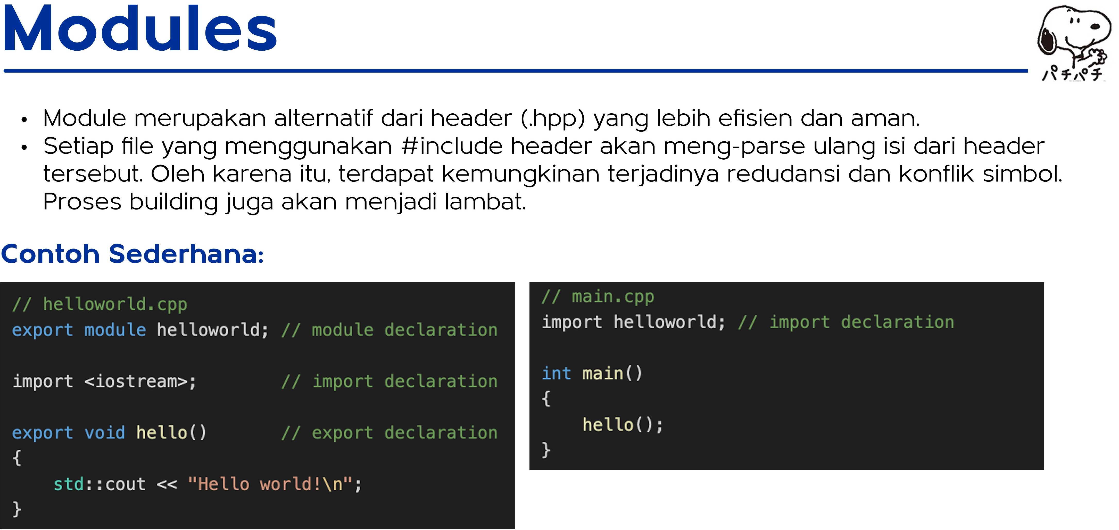

Slide 6
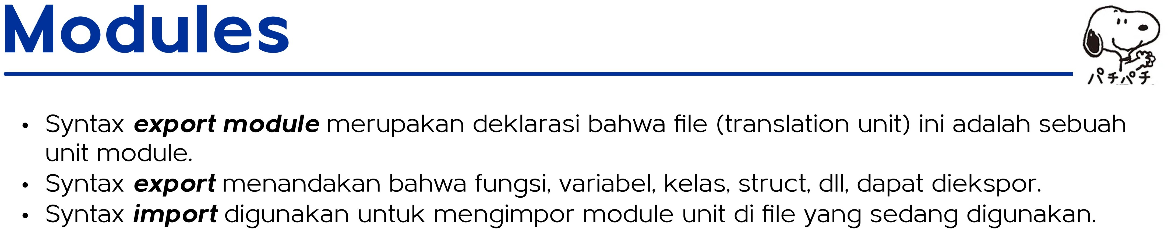

Slide 7
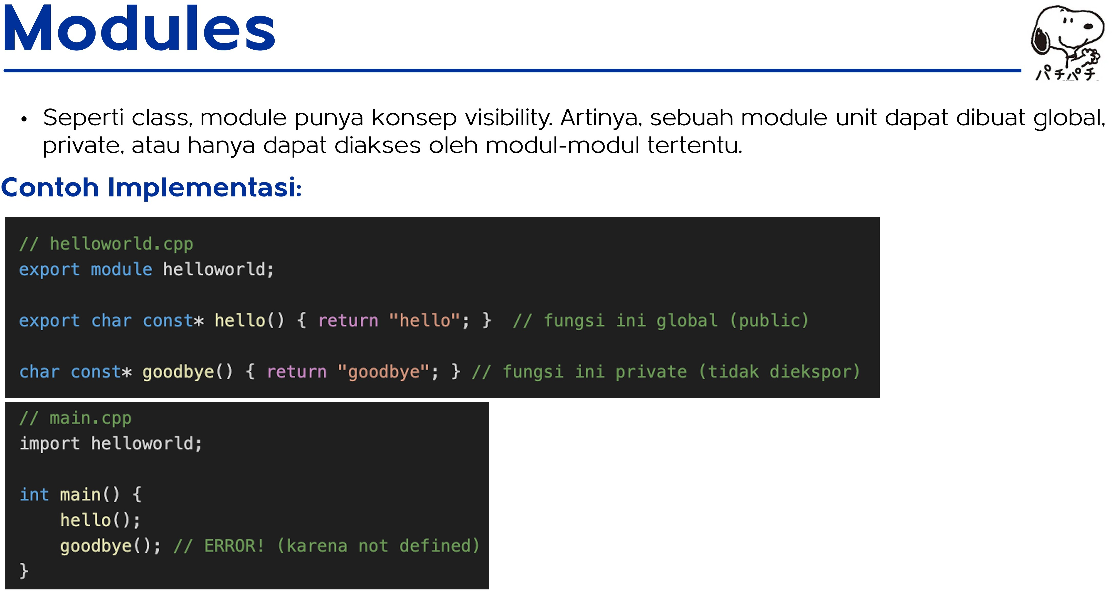

Slide 8
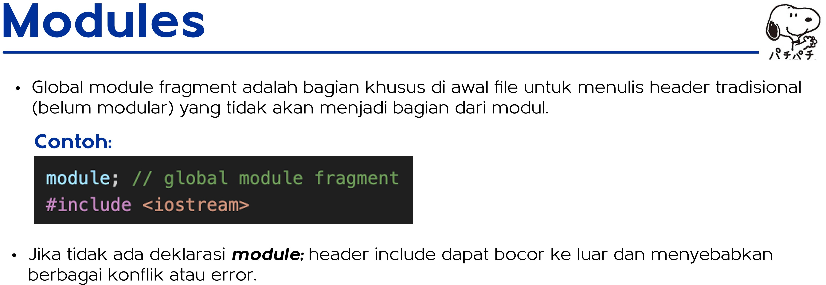

Slide 9
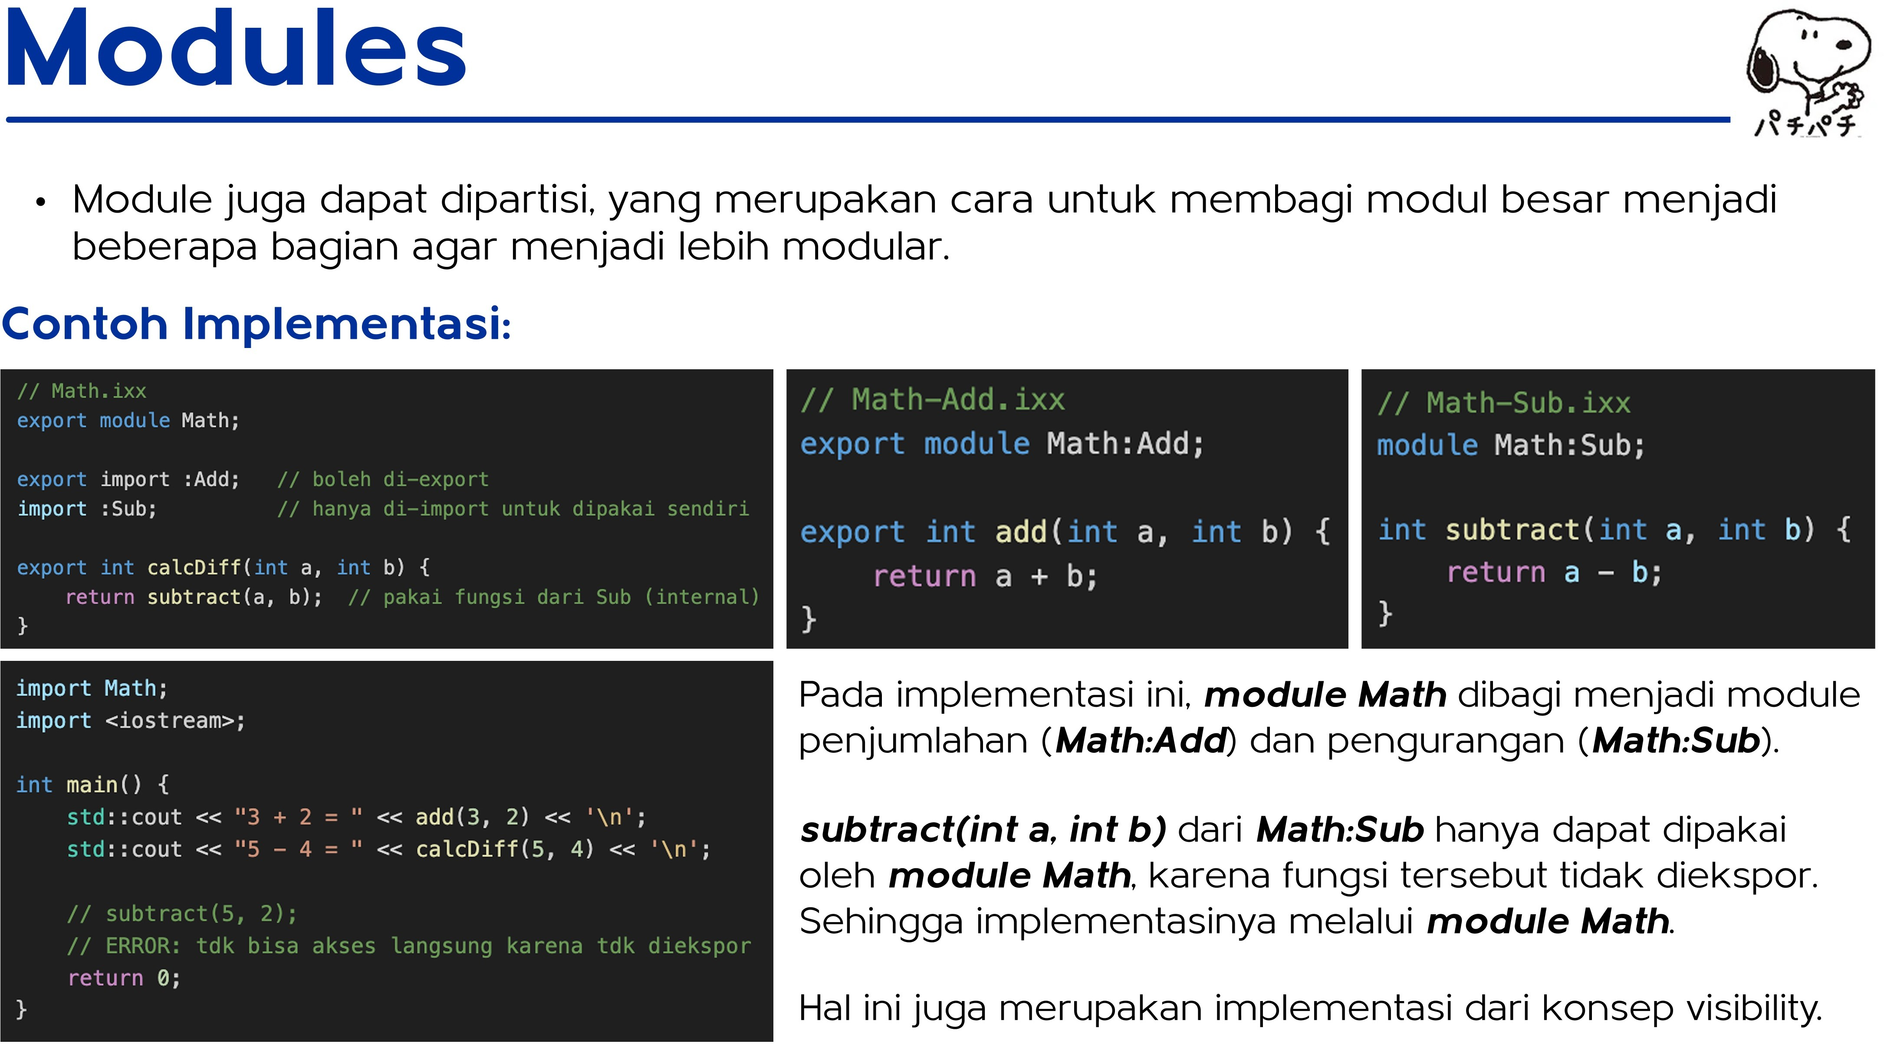

Slide 10
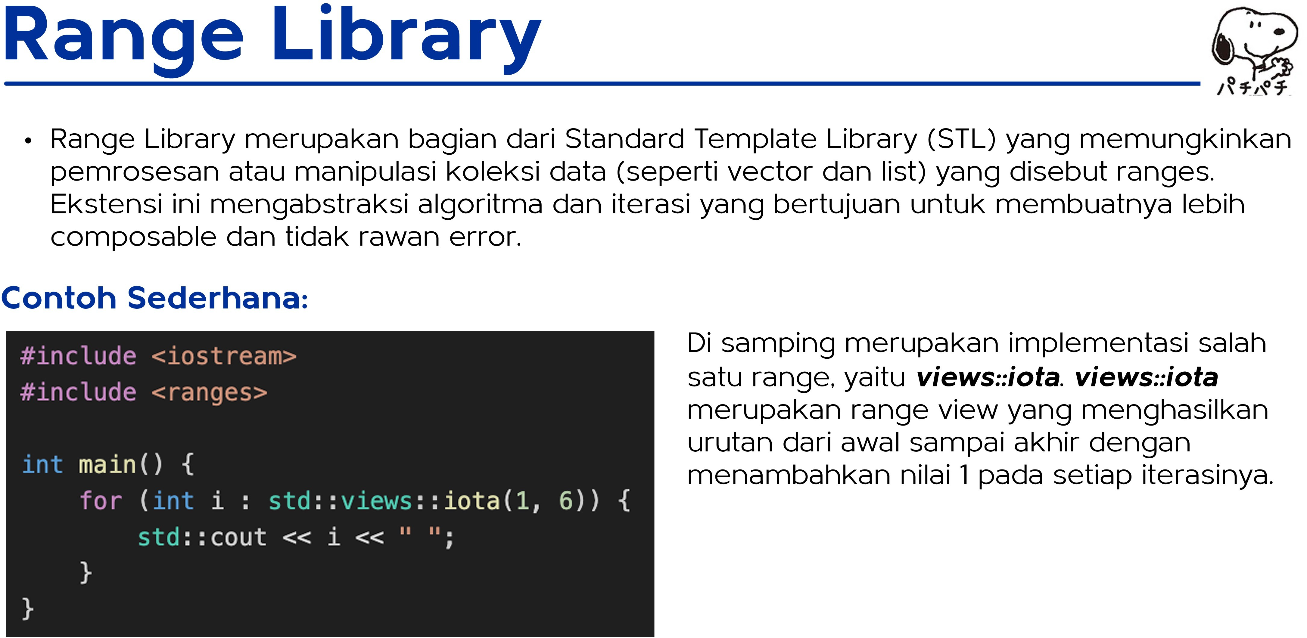

Slide 11
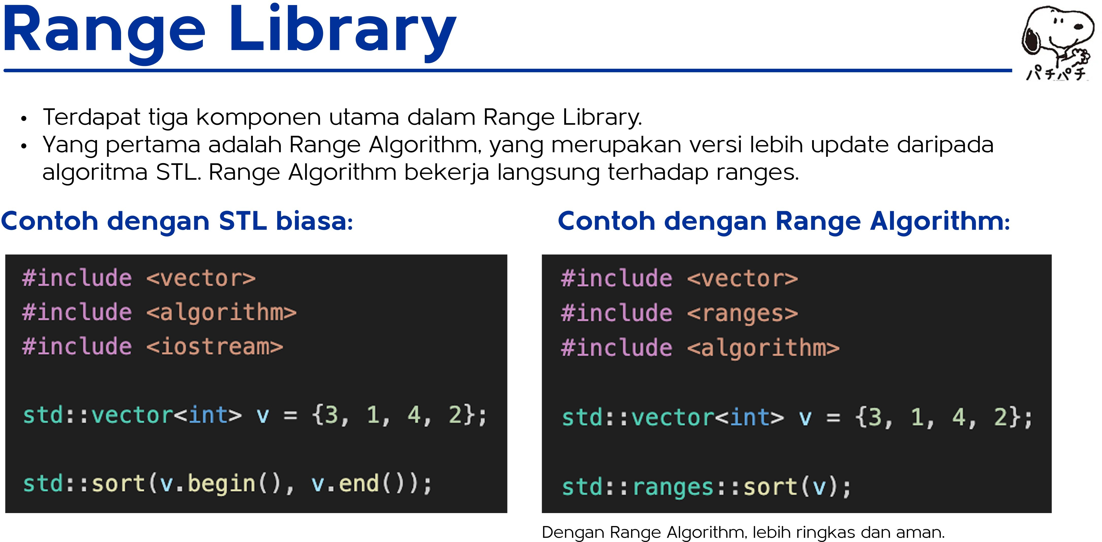

Slide 12
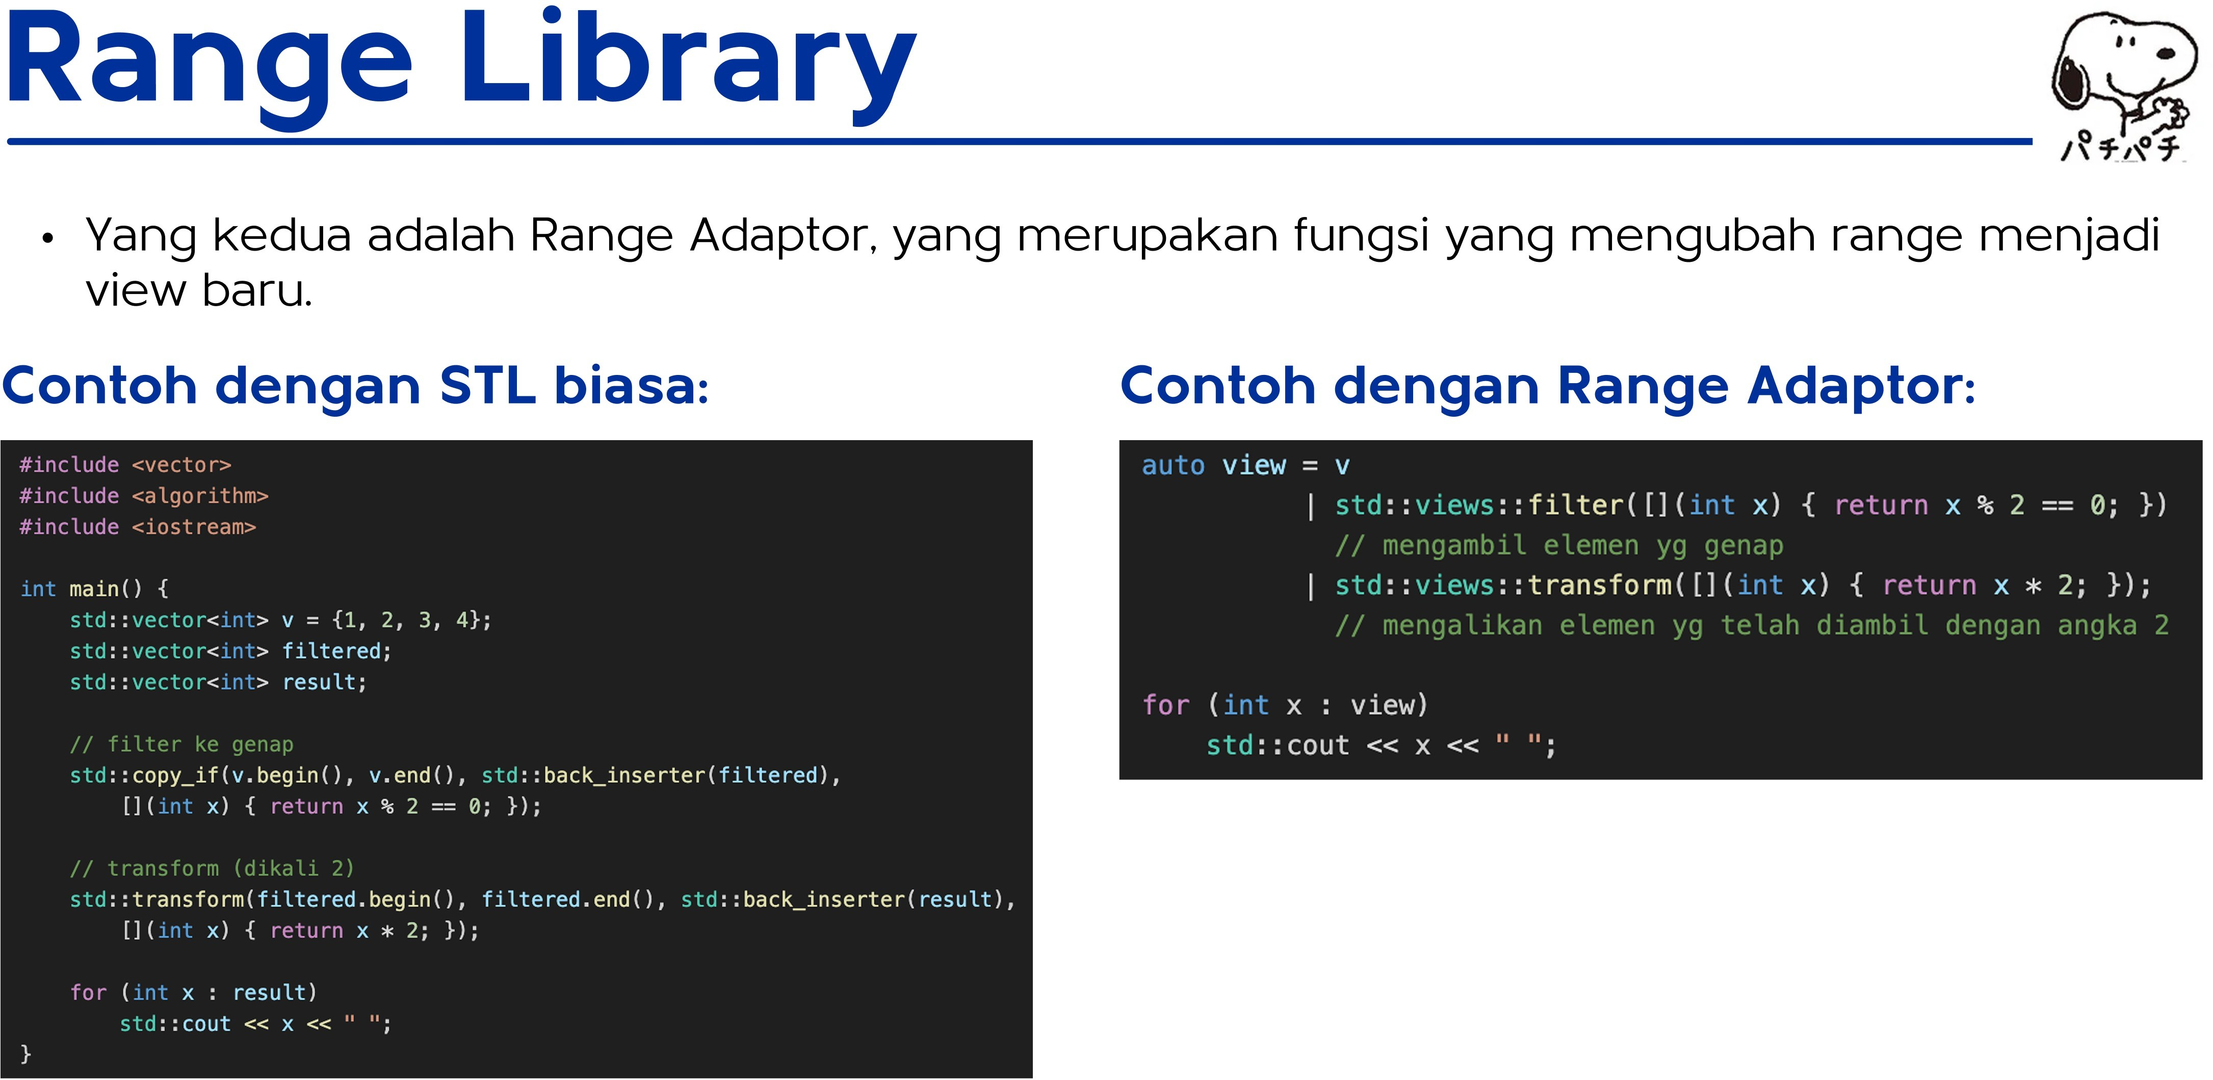

Slide 13
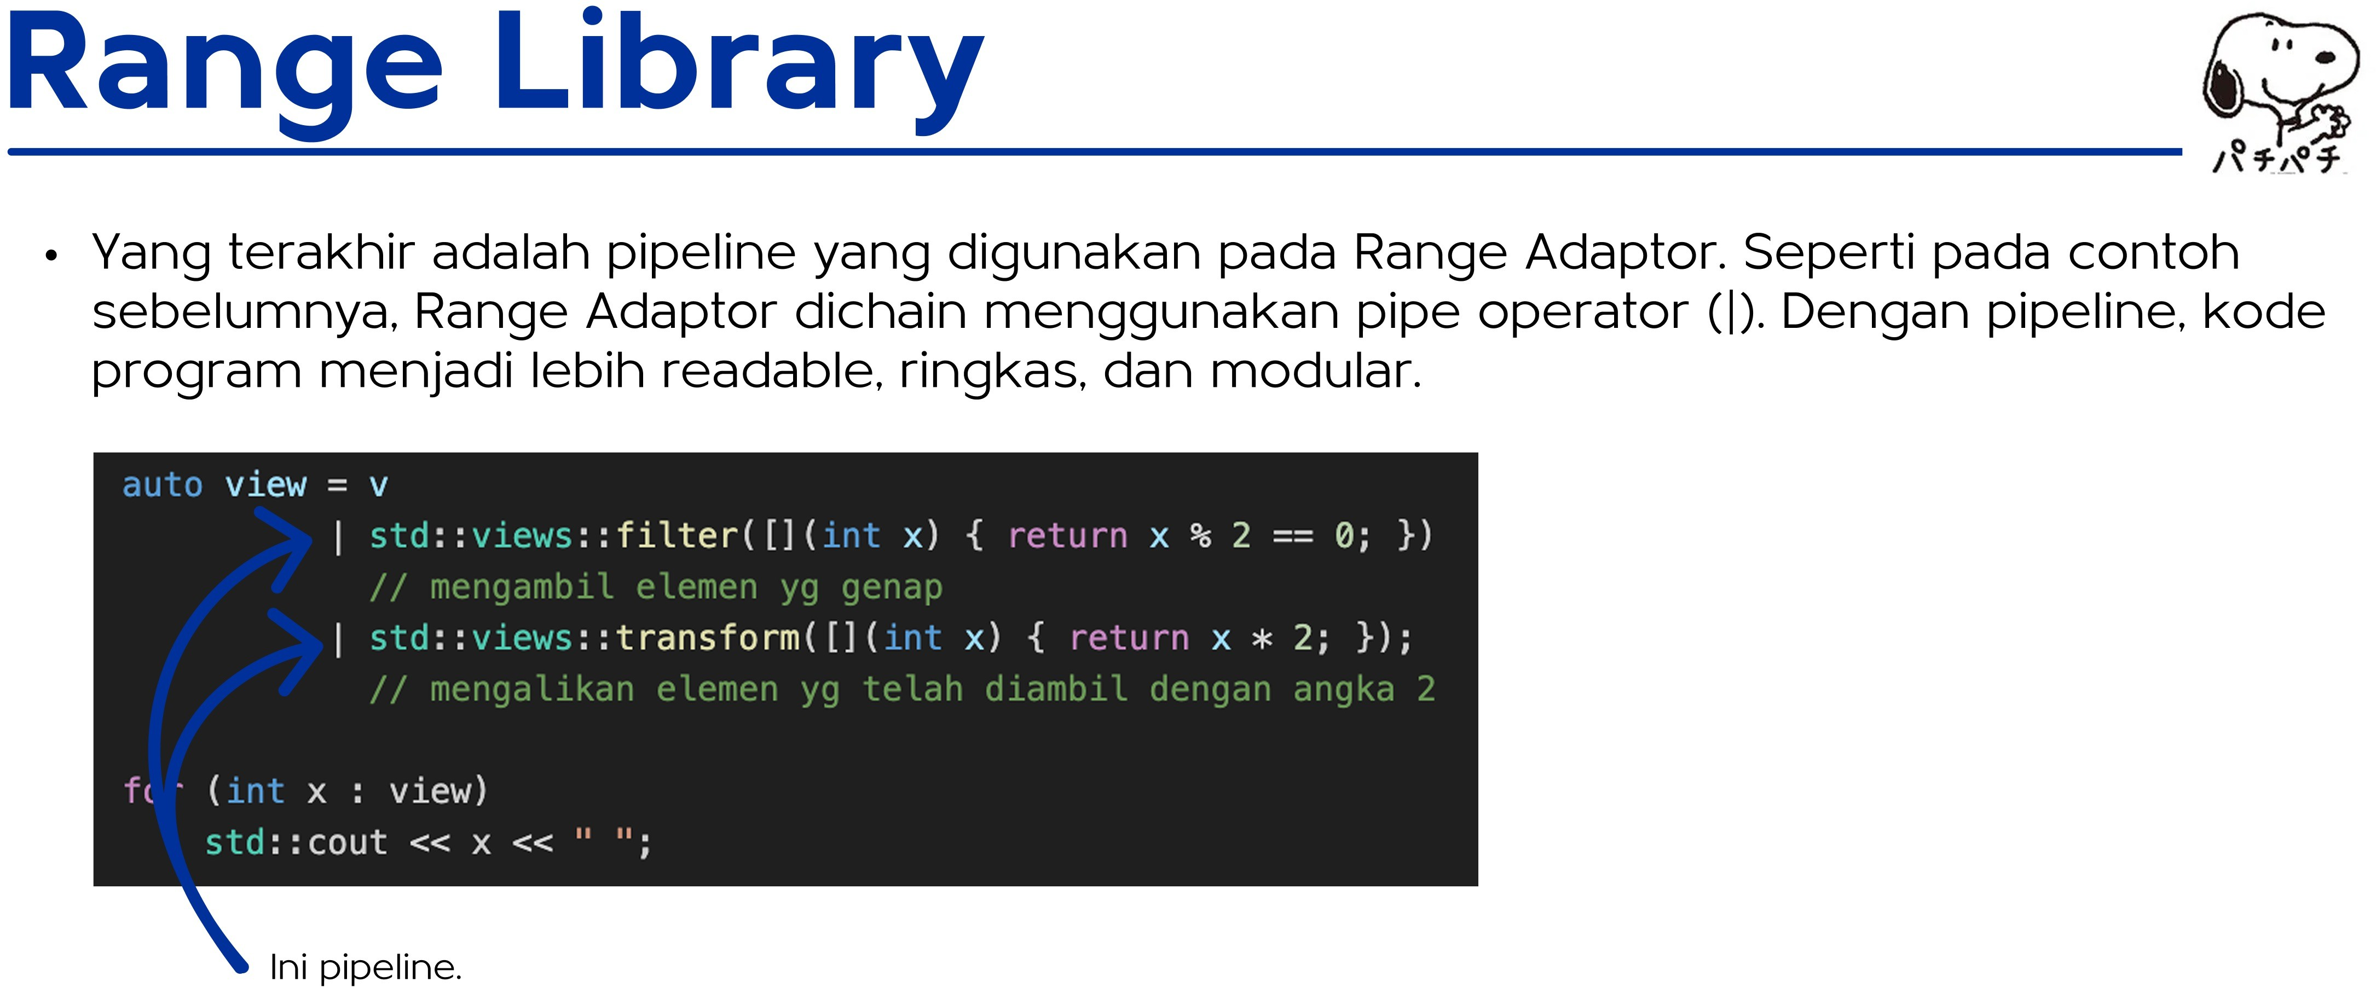

Slide 14
